Slide 1
Running through a linear model
Aimed at folks who haven’t done them before, or are vaguely aware of what they do, but don’t really understand.

Slide 2
Some caveats about this session
This is not geared towards teaching the coding.
Instead it is meant to try to help people understand what is going on in the black box of a lm
I am not an expert/statistician

Slide 3
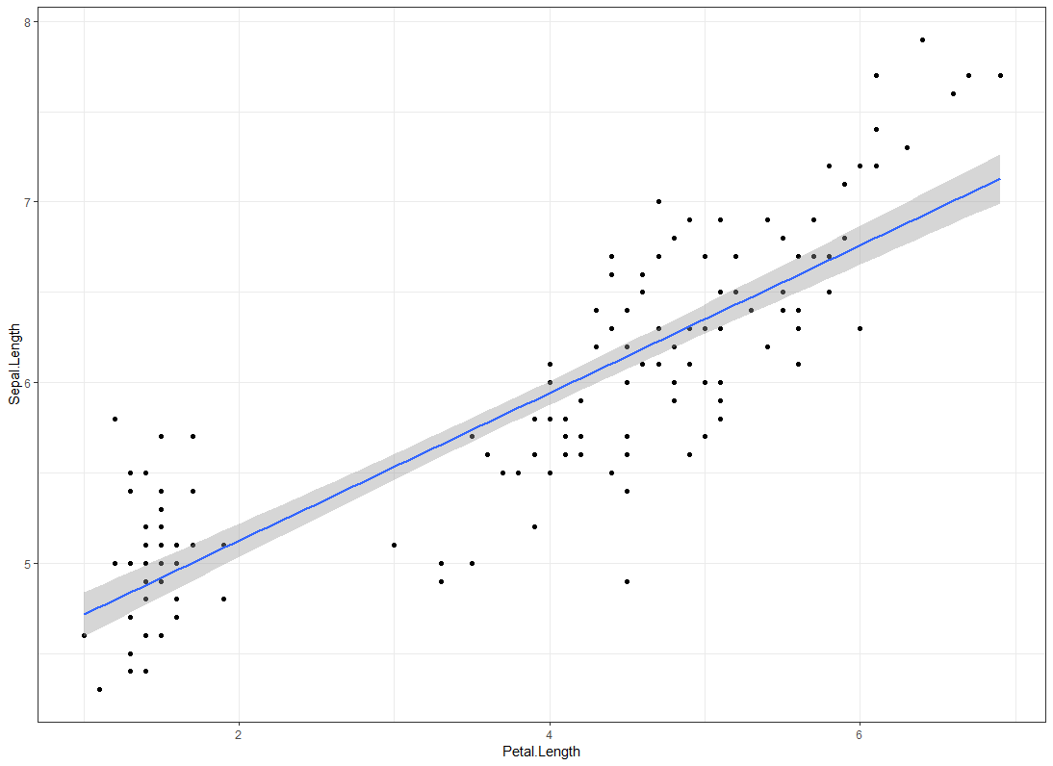
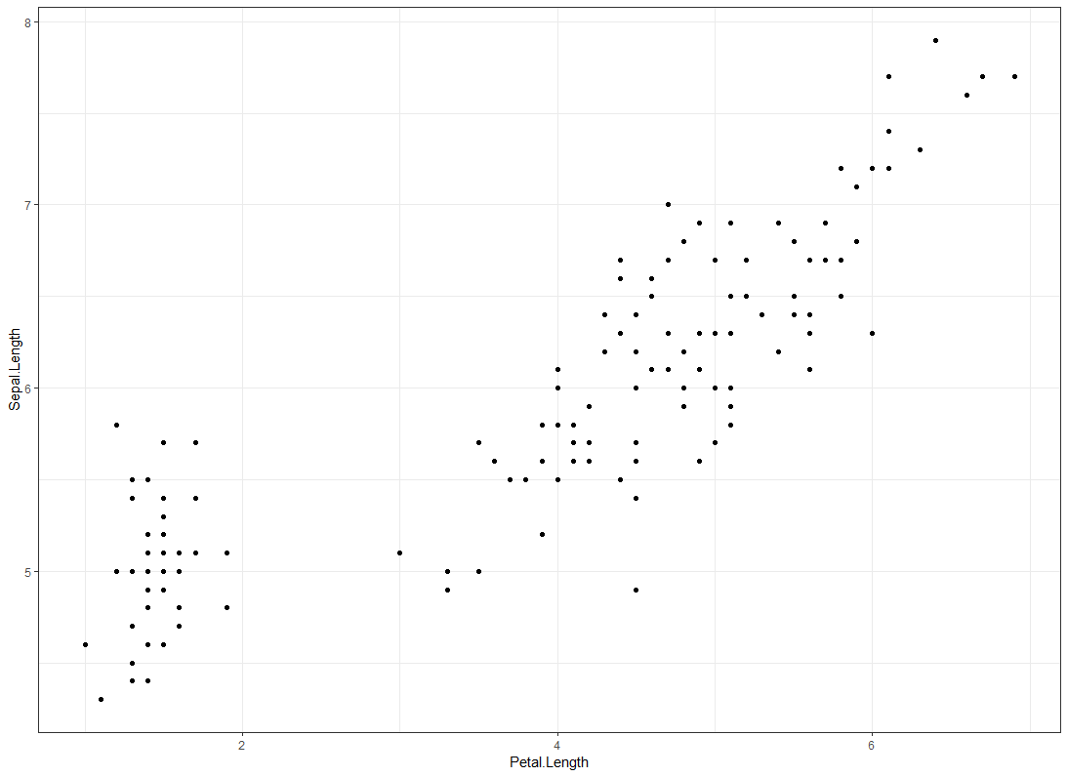
All a model does is draw a line through points

Slide 4

Remember your straight line equation?
$$y=mx+c$$
The y-intercept (when x = 0)
the response variable value
will be this
The response variable
The gradient based on a unit increase in the explanatory variable (x)

Slide 5
So for example our model equation for the previous figure will be:
We predict based on entering in values of petal length and solving the equation
We will be able to predict sepal lengths once we have a functioning linear model
$$sepal length=m(petal length)+c$$
It will also tell us what the y-intercept is.
A linear model will tell
us what m is.

Slide 6
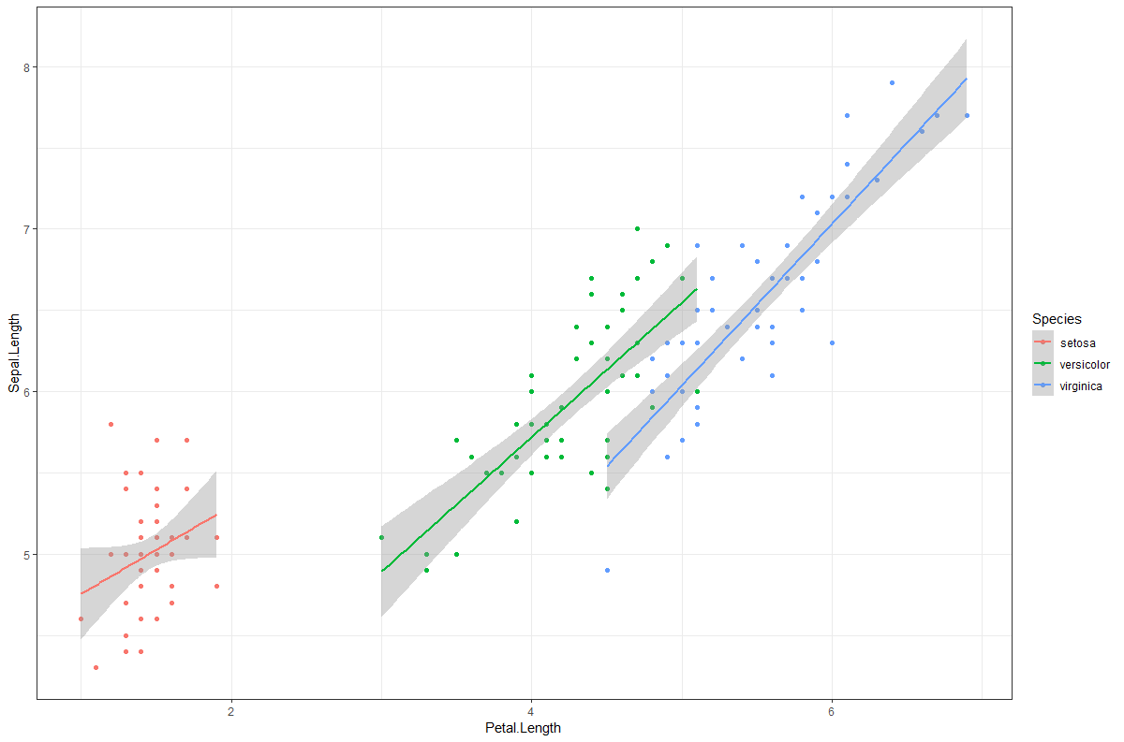
But we can make the model more complex to match our research question (e.g. with interactions at a first pass)

Slide 7

So for example our model equation for the previous figure will be:
$$sepal length= {m(petal length)}_{[setosa]}+c_{[setosa]}$$
$$sepal length= {m(petal length)}_{[versicola]}+c_{[versicola]}$$
$$sepal length= {m(petal length)}_{[virginica]}+c_{[virginica]}$$

Slide 8
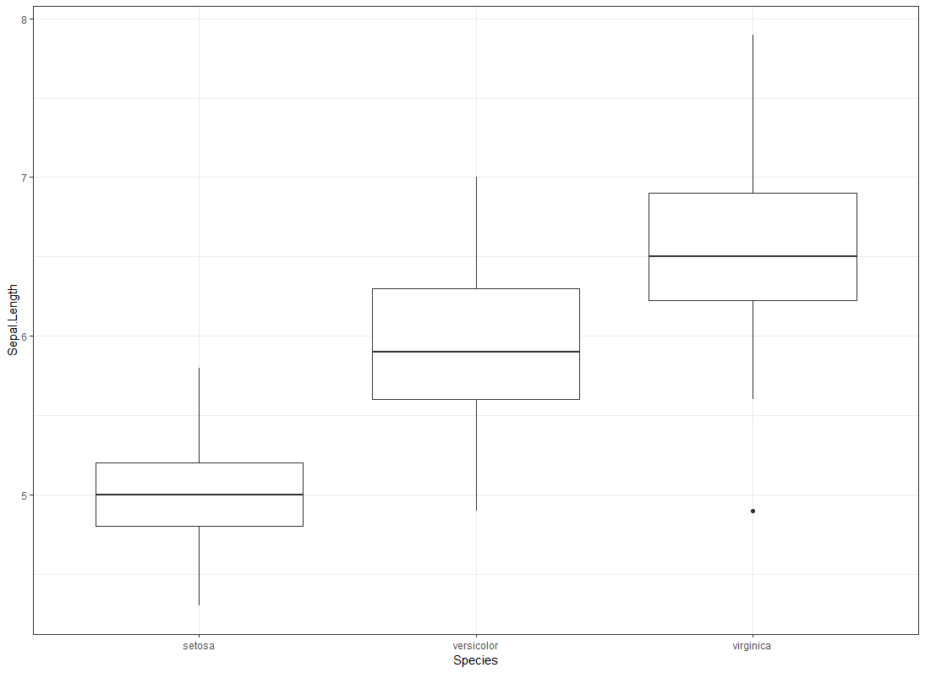
Model with additive terms versus a model with an interaction
Sepal length is explained by petal length and species (additive)

Slide 9
Model with additive terms versus a model with an interaction
Sepal length is explained by petal length and species (interaction)

Slide 10
Side note on linear models
All of the following do pretty much the same
lm(response ~ explanatory, data = data)
glm(response ~ explanatory, data = data)
glmm(response ~ explanatory, data = data)
gam(response ~ explanatory, data = data)
This is because all of these fall into the same “type” of analysis (“LGM”)
It’s only when you specify certain things within either glm or gam that they change from this.
E.g. glm(response ~ explanatory, data = data, family = poisson)
E.g. glmm(response ~ explanatory + (1|RE), data = data)
E.g. gam(response ~ s(explanatory, bs = “cr”), data = data)

Slide 11
How to get to that point: Workflow for doing a LM
10 steps to go through

Slide 12
STEP 1: Check your data and plot it
Get a feel for what’s going on in your data
Is R reading and importing your data correctly?
Can you see any clear data entry mistakes?
Can you spot trends that you expect to see?

Slide 13
How to check if R is reading your data correctly:
str(data) # returns the structure of your dataset
summary(data) # returns a summary of your data
head(data) # shows the first 6 rows of your data

Slide 14
How to plot your data using ggplot2:
ggplot(aes(x = “X.variable.name”,
y = “Y.variable.name”), # the aesthetics of the plot
data = data) + # what the data is called. The “+” tells R there is more to be added on
geom_point() # use the x & y above to plot points (scatterplot)
Note: you can do a lot more with ggplot, but the essence is the same. ggplot is built from multiple layers (each layer is added sequentially), so the graphs can be as simple or as complex as you want.
See Marianna’s Study Group Tutorial on how to use ggplot
You can also specify the aes() in each layer if you want different data in each of those layers.

Slide 15
STEP 2: Check for outliers
These can have impacts on how your line is drawn
Ones that have too much influence can throw off the model leading to crap interpretations
Outliers can be 2 things
Data entry mistakes
(In which case either fix if you can, or remove)
Biologically “extreme” values
These can present because you have limited data at the extreme of your data
Or they are just weird animals
(Either retain or remove)
STATE CLEARLY WHAT YOU HAVE DONE.

Slide 16
Code:
ggplot(aes(x = Species, y = Sepal.Length), data = iris) +
geom_boxplot() +
theme_bw()

Slide 17
STEP 3: Check distribution
Because we are using a linear model (which is just specific form of GLM: one with a Guassian family), we need our data to be normally distributed.
Data not being normal can throw off the model (if using lm)
Check and transform if needed.

Slide 18
Code:
ggplot() +
geom_histogram(aes(Sepal.Length), data = iris) +
theme_bw()

Slide 19
STEP 4: Check for collinearity
Explanatory variables being correlated with each other can mask effects of individual variables
Can you say if it is variable A or B that is influencing the response if they are correlated with each other?
Check if explanatories are correlated, and remove the one that is least interesting to your question (if correlated)
Be aware that there are other ways of dealing with correlated explanatories, but we’ll keep it simple for now.

Slide 20
Code:
# Creates a correlation plot
# Requires panel.cor function to be added to R
pairs(iris, lower.panel = panel.smooth, upper.panel = panel.cor)
# If you want to use GGally package:
ggpairs(iris)
# Or:
ggcorr(iris, method = c("everything", "pearson"))

Slide 21
STEP 5: Build the model
If you have a big dataset with lots of variables, do not add all variables into the model.
Models can run with garbage variables.

Slide 22
Code:
Model.1 <- lm(Sepal.Length ~ Species * Petal.Area, data = iris)

Slide 23
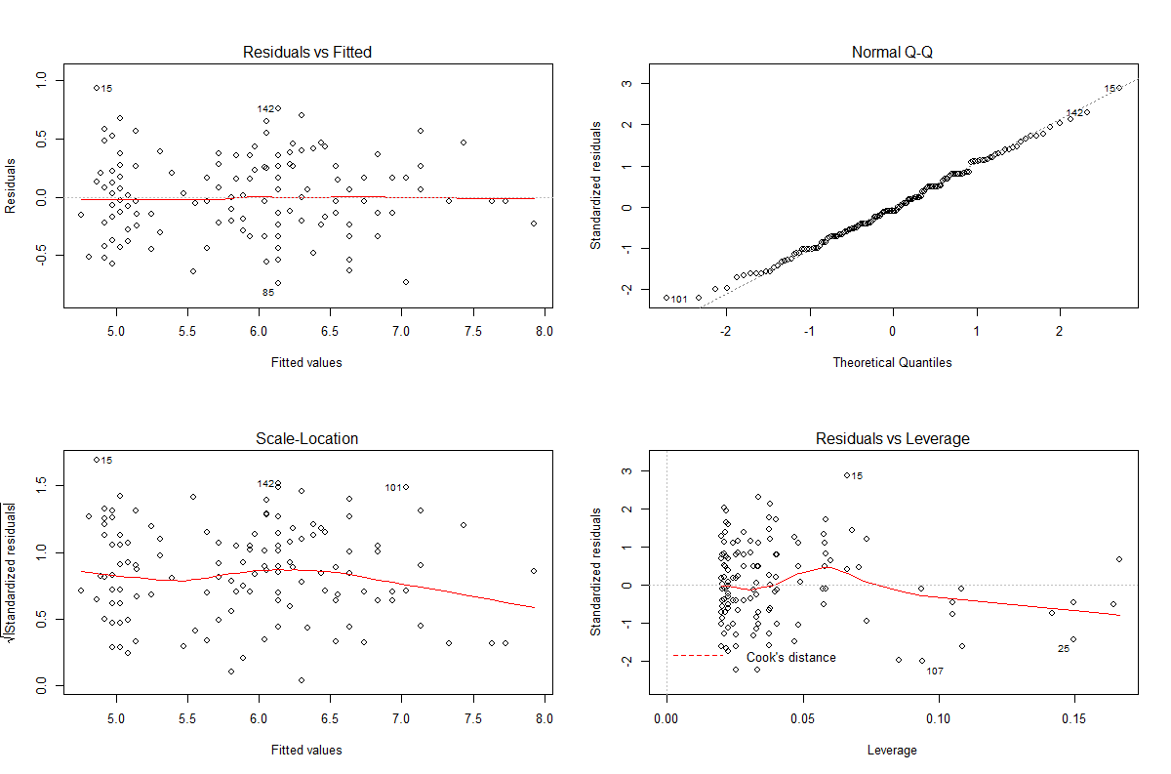
STEP 6: Run diagnostics on the model

Slide 24
Code:
# Set the window up to show 2 by 2 figures
par(mfrow = c(2,2))
plot(Model.1)
# Reset it to show 1 by 1 figure
par(mfrow = c(1,1))

Slide 25
STEP 7: Model selection
Models are meant to be parsimonious
Explain as much as possible, using as little as possible
(I.e. get to the meat of the relationship)
Use AIC for this – somewhat of an industry standard
(though there are alternatives – e.g. LRT)
deltaAIC < 2 means two models are indistinguishable as far as AIC is concerned

Slide 26
Code:
AIC(Model.1, Model.2, Model.3, Model.4)
anova(Model.1, Model.2, Model.3, Model.4, test = "Chisq")

Slide 27
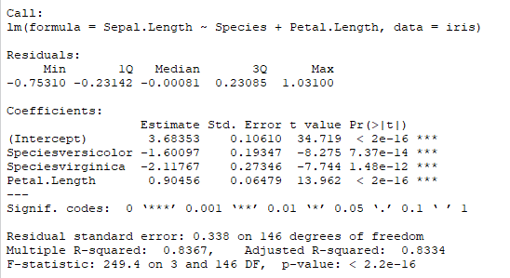
STEP 8: Interpret the model output

Slide 28
Code:
summary(Model.1)

Slide 29
STEP 9: Plot model results
Various ways of doing this
I’m currently using “jtools” package – much better than the effects package
Looks more similar to the ggplot style

Slide 30
Code:
# Requires the “jtools” package
interact_plot(Model.1, pred = Petal.Area, modx = Species, interval = TRUE, plot.points = T)

Slide 31
STEP 10: Publish in Nature etc

Slide 32
Code for publishing in nature:
df$diabetes.risk <- rnorm(5000, 15, 0.5)
df$climate.change <- rnorm(5000, 10, 0.5)
model.1 <- lm(diabetes.risk ~ climate.change, data = df)
effect_plot(model.1, pred = climate.change, interval = T)
generate.nature.paper(model.1, with = effect_plot, fatal.story = T)

